Slide 1
Creating Metadata in the Repository
Presenter:
February 16, 2018

Slide 2
Table of Contents
Creating Metadata in the Repository
01
Metadata from CSV (Delimited) file.
02
Metadata from XML file.
03
Metadata from Database Tables.
04
Metadata from Excel Files.
05
Metadata from JSON Files.

Slide 3
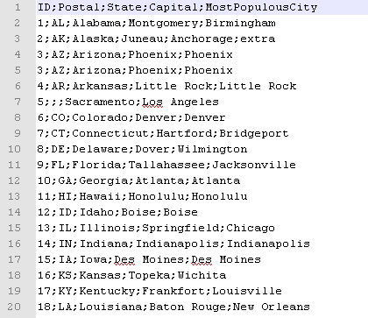
Metadata from CSV (Delimited) file.
Create a Repository Metadata for Delimited file from US_STATES.csv file. Snap shot of file below:
Copyright © 2014 by Vikram Takkar. All Rights Reserved..

Slide 4
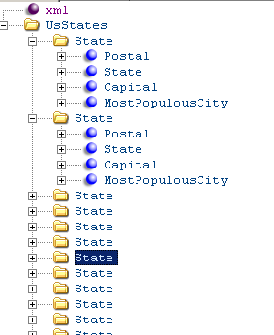
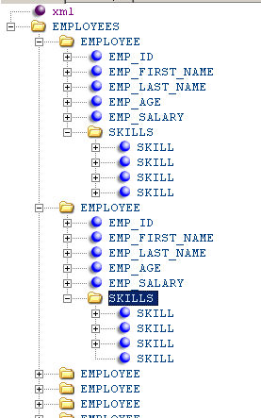
Metadata from XML file.
Create a Repository Metadata for XML from US_STATES.XML and EMPLOYEE.xml file.
Copyright © 2014 by Vikram Takkar. All Rights Reserved..

Slide 5
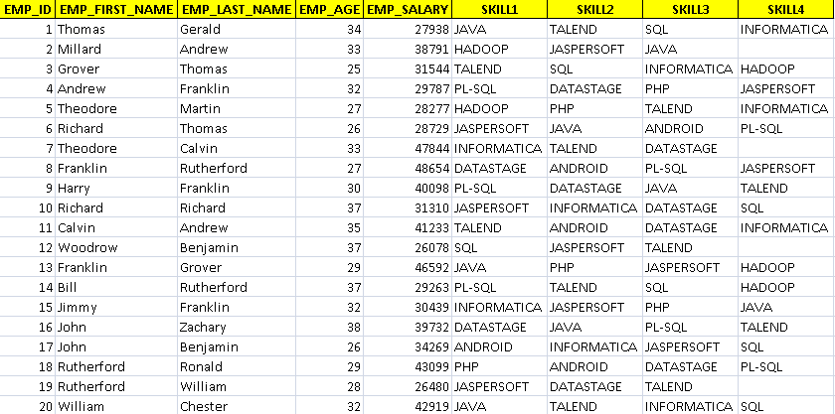
Metadata from Excel Files.
Create a Repository Metadata for Excel files from EMPLOYEE.xlsx file.
Copyright © 2014 by Vikram Takkar. All Rights Reserved..

Slide 6
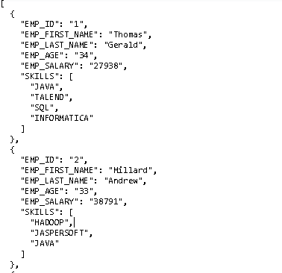
Metadata from JSON Files.
Create a Repository Metadata for Excel files from EMPLOYEE.json file.
Copyright © 2014 by Vikram Takkar. All Rights Reserved..

Slide 7
Metadata from Database Tables
Create a Repository Metadata for Database Connection from MySQL world database and retrieve schema for following tables:
City
Country
CountryLanguage
Copyright © 2014 by Vikram Takkar. All Rights Reserved..

Slide 8
Questions?
Copyright © 2014 by Vikram Takkar. All Rights Reserved..

